Slide 1
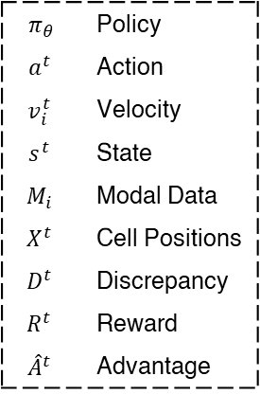
$π_{θ}$ | Policy
$$a^{t}$$ | Action
$$v_{i}^{t}$$ | Velocity
$$s^{t}$$ | State
$$M_{i}$$ | Modal Data
$$X^{t}$$ | Cell Positions
$$D^{t}$$ | Discrepancy
$$R^{t}$$ | Reward
$${\hat{A}}^{t}$$ | Advantage

